Slide 1

Department of Computer Science ,UIET Kathua
PRESENTATION
ON
“ Gesture Control System”
Submitted By : Under the Guidance of:
Abhishek Gupta(201603001) Er. Archana Salaria
Abhey Sharma (201603002)
Manish Sharma(201603011)
Raghav Khajuria(201603016)

Slide 2
Contents
Introduction
Objectives
Why?
Technologies Used
Workflow
Applications
Challenges
Future Scope

Slide 3
Introduction:
What is Gesture Control?
Gesture control refers to using hand and body movements to interact with digital devices without physically touching them.
Why is it Important?
Enhances user experience by providing a more natural and intuitive way to control devices.
Useful in various fields like gaming, presentations, robotics, and accessibility for individuals with disabilities.
About the Project:
Our project is a Gesture Control System.
It uses a webcam to track hand movements.
The system recognizes specific gestures to control computer applications.
We integrated it with PowerPoint for controlling presentations using hand gestures.
Our project uses Python and its libraries.

Slide 4
p
Objectives:
1. Develop a Gesture Control System:
Create a system that can recognize and interpret hand gestures.
2. Implement Hand Tracking and Gesture Recognition:
Detect hand positions and movements to recognize specific gestures.
3. Control Computer Applications:
Use recognized gestures to control various computer functions (like moving the cursor, clicking, scrolling).
4. Integrate with Presentation Software:
Enable control of PowerPoint presentations through hand gestures for easier and more interactive presentations.

Slide 5
Why?
1. Accessibility:
Arthritis: Joint pain and stiffness can make gripping a mouse painful.
Carpal Tunnel Syndrome: Causes pain, numbness, and tingling in the hand and arm, making prolonged use of a mouse uncomfortable.
General Mobility Issues: Helps users who struggle with fine motor skills or have limited hand dexterity.
2. Ease of Use:
Intuitive and natural interaction.
Reduces strain on hands and wrists.
3. Modern Interaction:
Aligns with the trend towards touchless technology.
Provides a futuristic and innovative way to interact with computers.

Slide 6
4. Hygiene:
Reduces the need to touch shared devices, promoting better hygiene, especially important in shared environments.
5. Productivity:
Allows for multitasking without the need for physical devices.
Can speed up certain tasks with quick gestures.
6. Entertainment:
Enhances the experience in gaming and multimedia applications.
Provides a novel way to interact with virtual reality and augmented reality environments.
7. Inclusivity:
Makes technology more inclusive, allowing more people to use computers effectively.
Ensures that technology can be used by everyone, regardless of physical limitations.

Slide 7
Major Technologies Used:
OpenCV (Open Source Computer Vision Library) is an open-source computer vision and machine learning software library. It provides a wide range of functionalities for image and video processing, including object detection, facial recognition, and gesture tracking.
Usage in the Project:
Webcam Access: OpenCV is used to access the webcam and capture live video frames. The cv2.VideoCapture() function establishes a connection to the webcam, allowing the system to receive a continuous stream of video frames.
Image Processing: OpenCV provides functionalities for image processing, such as color space conversion (cv2.cvtColor()), drawing shapes on images (cv2.circle(), cv2.rectangle()), and displaying images (cv2.imshow(), cv2.waitKey()). These are utilized for visualizing the hand tracking results and interacting with the user.
Hand Tracking: Although MediaPipe is primarily used for hand tracking, OpenCV still plays a role in processing the video frames before passing them to MediaPipe. OpenCV's image processing capabilities can be used to enhance the quality of input frames, adjust brightness and contrast, or apply filters if needed.

Slide 8
MediaPipe is an open-source framework developed by Google that offers
customizable machine learning solutions for various multimedia tasks. It provides
ready-to-use machine learning models and pipelines for tasks like object
detection, pose estimation, hand tracking, and facial recognition.
Usage in the Project:
Hand Tracking Model: MediaPipe provides a pre-trained machine learning model for hand tracking, specifically the mp.solutions.hands module. This model is capable of detecting and tracking the landmarks (key points) of the hand in real-time.
Landmark Detection: MediaPipe's hand tracking model analyzes each video frame received from OpenCV and detects the positions of various landmarks on the hand, such as fingertips, knuckles, and palm. These landmarks are crucial for interpreting hand gestures accurately.
Gesture Recognition: Based on the detected landmarks, MediaPipe's hand tracking model can recognize various hand gestures. These gestures are then mapped to specific actions, such as moving the cursor, clicking, scrolling, or controlling a presentation.

Slide 9
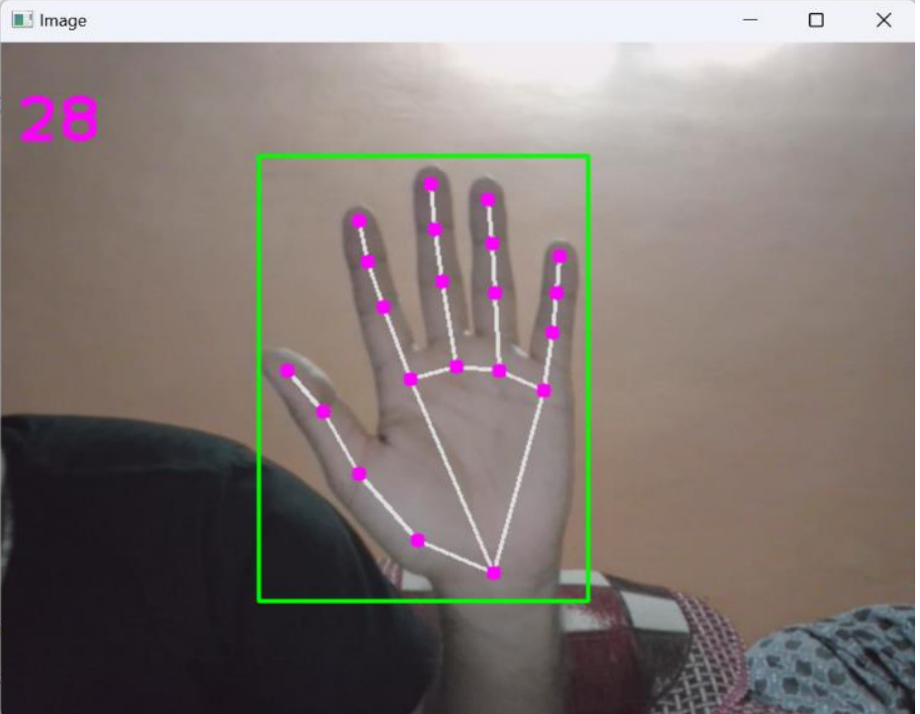
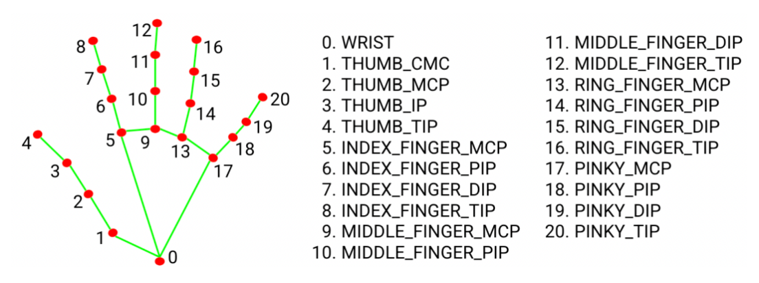
Fig: Detection and Conversion to Hand Landmarks

Slide 10
Other Technologies Used:
PyAutoGUI
Autopy
Comtypes
Inno Setup
cx_freeze
numpy
time
os
keyboard
math

Slide 11
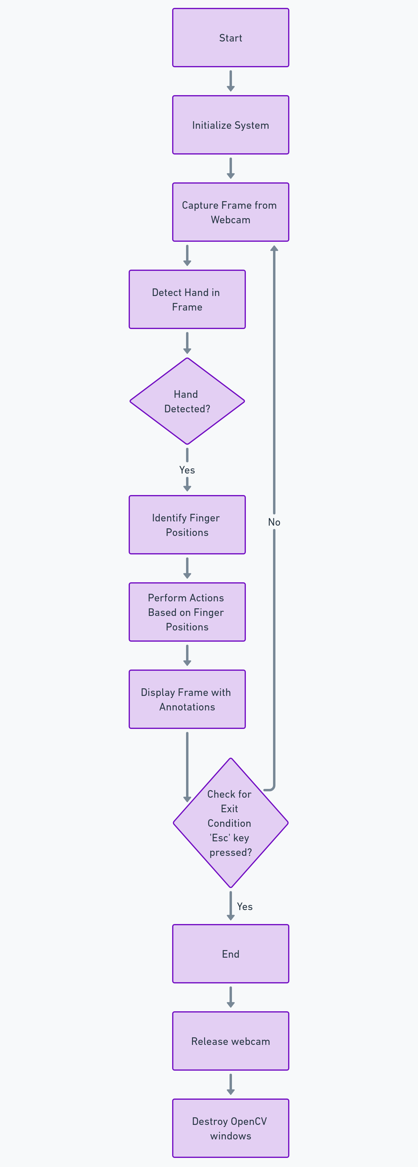
WorkFlow
Start: Program begins execution.
Initialize System: Set up webcam and hand detector, define frame dimensions and screen size, initialize variables.
Capture Frame from Webcam: Obtain a frame from the webcam using OpenCV.
Detect Hand in Frame: Convert image to RGB and process with Mediapipe to detect hand landmarks.
Check if Hand is Detected: Verify if hand landmarks are detected in the frame.

Slide 12
6. Identify Finger Positions: Determine positions of key fingers (index,
middle, thumb) and identify which fingers are raised.
7. Perform Actions Based on Finger Positions: Execute various actions
based on finger positions, such as cursor movement, clicks, right
clicks, dragging, double-clicking, scrolling, and presentation control.
8. Display Frame with Annotations: Annotate the frame with detected
landmarks and visual cues using OpenCV and display it in a window.
9. Check for Exit Condition: Monitor if the 'Esc' key is pressed to stop the script.
10. End: Release webcam resource and close all OpenCV windows.

Slide 13
Applications:
1. Education and Business
Interactive Presentations
Multimedia Control
Accessibility
Enhanced Mobility
2. Healthcare
Gesture control can be utilized in medical simulations and training programs to simulate surgical procedures, manipulate medical images, and interact with virtual patient data.
3. Gaming and Entertainment
Gesture control can enhance gaming experiences by allowing players to interact with games using natural hand movements, gestures, and motions. Gesture control can enable users to interact with virtual environments, manipulate objects, and engage in immersive experiences without the need for physical controllers.

Slide 14
Challenges:
Hand Detection Accuracy: Variations in lighting, hand sizes, and occlusions challenge achieving precise hand detection, requiring sophisticated algorithms and parameter tuning for robustness.
Real-time Responsiveness: Balancing seamless user experience with minimal latency in translating hand movements into mouse actions is challenging, especially with resource-intensive image processing tasks and complex gesture recognition algorithms.
Limitation to Specific Presentation File: Dependency on a specific presentation file in the program folder limits flexibility and usability, requiring users to store the presentation file within the program directory, potentially leading to errors if requirements are not met.

Slide 15
Future Scope:
Improved Accuracy and Speed: Incorporating advanced machine learning models and GPU acceleration can enhance the system's accuracy and speed, ensuring more precise hand detection and faster gesture recognition for a seamless user experience.
Multi-Hand Support: Implementing dual hand tracking enables recognition and tracking of gestures from both hands simultaneously, allowing for more complex interactions and commands, thus expanding the system's capabilities.
Integration with More Applications: Extending functionality to control various applications beyond PowerPoint, coupled with API development for easy integration, opens up opportunities for broader usage scenarios, such as media players, browsers, and gaming interfaces, enhancing the system's versatility and usability.

Slide 16

Thank You

